Slide 1
ARM Software Track
Arnab Basu
Bhupesh Sharma
Prabhakar Kushwaha
Shaveta Leekha

Slide 2
Track 2 Agenda
Track 1 : 8th Oct 2013
ARMv7 Recap
ARM Procedure Call Standard(APCS)
ARM Functional Model
ARM Bring up/Boot up (Simple hardware)
ARM Bring up/Boot up (Complex hardware)
Track 2 : 17th Oct 2013
ARM Instruction Set
ARM Interrupt Model
ARM Development Tools
RealView ICE

Slide 3
ARM Instruction Set

Slide 4
ARM, THUMB
The ARM instruction set provides the definitive and complete 32-bit instructions for the ARM architecture.
The Thumb instruction set is an extension to the 32-bit ARM architecture that enables very high code density
features a subset of the most commonly used 32-bit ARM instructions which have been compressed into 16-bit wide operation codes
Some examples of “compression”:
Removed conditional execution
3 register format changed to 2 register format
Where Thumb instructions are available, they provide most of the functionality of the 32-bit ARM instruction set, but some operations require more instructions
An improvement in code density of around 30 percent (compared with the full ARM instruction set)
(Source: “Improving ARM Code Density and Performance”, ARM doc from 2003)

Slide 5
THUMB - Disadvantages
Since there is no difference in the time taken to fetch an instruction, in situations where more THUMB instructions are required to accomplish the same functionality, ARM code will show a performance advantage over THUMB
Not all ARM instructions have THUMB equivalents, so some ARM instructions must still be used even when the target is the highest code density

Slide 6
THUMB-2
Thumb + 32-bit Thumb instructions derived from ARM instruction equivalents
32-bit Thumb instructions fill the gaps where ARM instructions were previously required
Memory footprint which is just 74 percent of an ARM-equivalent implementation
i.e. marginally larger than Thumb alone
Performance is comparable to ARM
(Source: “Improving ARM Code Density and Performance”, ARM doc from 2003)

Slide 7
Instruction Encoding
All ARM instructions have a fixed length of 32 bits
This, together with the (mostly) fixed positions of the source operands allows decoupling of the fetch & decode logic, i.e. operand fetch can begin before the opcode is fully decoded
These 32 bits need to encode
condition code,
op code,
source register,
destination register and
immediate operand/second source register

Slide 8
Immediate Operands - Challenges
Only 12 bits are available to encode an immediate operand in an instruction
Only 4096 distinct values
Two solutions
Barrel shifter
Literal Pools

Slide 9
Barrel Shifter
No actual shift operations in ARM
Has something called the Barrel Shifter which carries out shifts as part of other operations
In most ARM instructions the 2nd operand is sent to the ALU via the barrel shifter

Slide 10
Barrel Shifter – Supported Operations
LSL : Logical Left Shift
ASR: Arithmetic Right Shift
CF
Destination
0
Destination
CF
Multiplication by a power of 2
Division by a power of 2, preserving the sign bit
LSR : Logical Shift Right
ROR: Rotate Right
...0
Destination
CF
Destination
CF
Division by a power of 2
Bit rotate with wrap around from LSB to MSB
RRX: Rotate Right Extended
Destination
CF
Single bit rotate with wrap around from CF to MSB

Slide 11
Using the Barrel Shifter
Register, optionally with shift operation
Operand 1
Operand 2
Barrel Shifter
Immediate value
ALU
Result

Slide 12
Barrel Shifter: Shifter Register
The amount by which the register is to be shifted is contained in either:
the immediate 5‐bit field in the instruction
No Overhead
Shift is done for “free” i.e. executes in single cycle.
the bottom byte of a register (not PC)
Then takes extra cycle to execute
ARM doesn’t have enough read ports to read 3 registers at once.
Then same as on other processors where shift is separate instruction.
If no shift is specified then a default shift is applied: LSL #0
i.e. barrel shifter has no effect on value in register.

Slide 13
Barrel Shifter: Immediate Operand
The 12 bits available to encode the immediate operand are split as follows:
4 bit rotation field, r (bits 8 to 11)
8 bit number n, (bits 0 to 7)
The immediate operand is constructed using the formula
operand = n ROR (2*r) ; [ROR -> rotate right]
This increases the range of the immediate constant, but not all numbers can be encoded using this formula
limited to numbers that can be expressed using even number of shifts of an 8 bit value
0 – 255 [0 - 0xff]
256,260,264,..,1020 [0x100 - 0x3fc, step 4, 0x40 - 0xff ror 30]
1024,1040,1056,..,4080 [0x400 - 0xff0, step 16, 0x40 - 0xff ror 28]
4096,4160, 4224,..,16320 [0x1000 - 0x3fc0, step 64, 0x40 - 0xff ror 26]

Slide 14
Barrel Shifter: Immediate Operand Examples
e3a000ff mov r0, #255 ; 0xff
0xe3a000ff => 0b1110 0011 1010 0000 0000 0000 1111 1111
1110 => condition code 'always'
00 => always for data processing instructions
1 => I bit i.e. operand2 is immediate
1101 => Operand , MOV - Rd:= Op2
0 => S bit, i.e. do not update condition code in CPSR
0000 => Rn, dont care in this case
0000 => Rd, r0
0000 1111 1111 => Immediate operand, r = 0, n 255
e3a010ff mov r1, #255 ; 0xff
0xe3a010ff => 0b1110 0011 1010 0000 0001 0000 1111 1111
0001 => Rn is r1
e3a004ff mov r1, #-16777216 ; 0xff000000
0xe3a004ff => 0b1110 0011 1010 0000 0000 0100 1111 1111
0100 1111 1111 => Immediate operand, r = 4, n = 255

Slide 15
Literal Pool
If constant cannot be encoded by an even right shift of 8 bits, the assembler:
places the value in a literal pool (a portion of memory embedded in the code to hold constant values)
generates an LDR instruction with a PC-relative address that reads the constant from the literal pool
The assembler places a literal pool at the end of each section.
The offset from the PC to the constant must be:
less than 4KB in ARM, but can be in either direction

Slide 16
Literal Pool – 2
In large sections the pool can be out of range of one or more LDR instructions.
If the next literal pool is out of range, the assembler generates an error message
“Error: invalid literal constant: pool needs to be closer”
must place literal pools where the processor does not attempt to execute them as instructions.
after unconditional branch instructions,
after the return instruction at the end of a subroutine.

Slide 17
LDR Pseudo Instruction
Assembler provides a method which will load ANY 32 bit constant:
LDR rd,=numeric constant
if the constant can be constructed using either a MOV or MVN then this will be the instruction actually generated
otherwise, the assembler will produce an LDR instruction with a PC‐relative address to read the constant from a literal pool.
this mechanism will always generate the best instruction for a given case

Slide 18
Conditional Execution
Most instructions contain a condition field which determines whether the CPU will execute them.
Non‐executed instructions consume 1 cycle.
Can’t collapse the instruction like a NOP. Still have to complete cycle so as to allow fetching and decoding of the following instructions.
This removes the need for many branches, which stall the pipeline (3 cycles to refill).
Allows very dense in‐line code, without branches.
The Time penalty of not executing several conditional instructions is frequently less than overhead of the branch or subroutine call that would otherwise be needed.

Slide 19
Branch Instructions
B{<cond>} label
branch
pc = label
BL{<cond>} label
branch with link
pc = label
lr = address of the next instruction after the BL
BX{<cond>} Rm
branch exchange
pc = Rm & 0xfffffffe, T = Rm & 1
BLX{<cond>} label | Rm
branch exchange with link
pc = label, T = 1
pc = Rm & 0xfffffffe, T = Rm & 1
lr = address of the next instruction after the BLX
address label is stored in the instruction as a signed pc-relative offset
must be within approximately 32 MB of the branch instruction
T refers to the Thumb bit in the cpsr.
When instructions set T, the ARM switches to Thumb state.

Slide 20
Single Register Data Transfer
Syntax:
LDR{<cond>}{<size>} Rd, <address>
STR{<cond>}{<size>} Rd, <address>
when <size> is not given transfer is word sized
Size also can be
b => byte
sb => signed byte
w => word
sw => signed word

Slide 21
Addressing
Address accessed by LDR/STR is specified by a base register plus an offset
It can be specified as
An unsigned 12-bit immediate value (ie 0 - 4095 bytes). LDR r0,[r1,#8]
A register, optionally shifted by an immediate value LDR r0,[r1,r2] LDR r0,[r1,r2,LSL#2]
This can be either added or subtracted from the base register: LDR r0,[r1,#-8] LDR r0,[r1,-r2] LDR r0,[r1,-r2,LSL#2]
Choice of pre-indexed or post-indexed addressing

Slide 22
Pre / Post Indexing
Pre-indexed: STR r0,[r1,#12]
Offset
r0
Source Register for STR
12
0x20c
0x5
0x5
r1
Base Register
0x200
0x200
Auto-update form: STR r0,[r1,#12]!
Post-indexed: STR r0,[r1],#12
Updated Base Register
r1
Offset
0x20c
12
0x20c
r0
Source Register for STR
Original Base Register
r1
0x5
0x200
0x5
0x200

Slide 23
Load / Store Multiple
Syntax:
<LDM|STM>{<cond>}<addressing_mode> Rb{!}, <register list>
4 addressing modes:
LDMIA / STMIA increment after
LDMIB / STMIB increment before
LDMDA / STMDA decrement after
LDMDB / STMDB decrement before
IA
IB
DA
DB
LDMxx r10, {r0,r1,r4}
STMxx r10, {r0,r1,r4}
r4
r4
r1
r1
r0
Increasing Address
Base Register (Rb)
r10
r0
r4
r1
r4
r0
r1
r0

Slide 24
Implementing stacks with LDM and STM
For stack operations, the base register is usually the stack pointer, sp.
This means that you can use these instructions to implement push and pop operations for any number of registers in a single instruction.
Types of stack
Descending or ascending
The stack grows downwards, starting with a high address and progressing to a lower one (a descending stack), or upwards, starting from a low address and progressing to a higher address (an ascending stack).
Full or empty
The stack pointer can either point to the last item in the stack (a full stack), or the next free space on the stack (an empty stack).

Slide 25
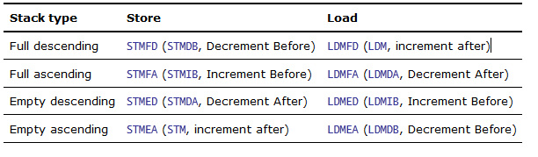
Implementing stacks with LDM and STM - 2
stack-oriented suffixes can be used instead of the increment or decrement, and before or after suffixes
The Procedure Call Standard for the ARM Architecture (AAPCS), and ARM and Thumb C and C++ compilers always use a full descending stack.
The PUSH and POP instructions assume a full descending stack. They are the preferred synonyms for STMDB and LDM with writeback.

Slide 26
SWI
A software interrupt instruction (SWI) causes a software interrupt exception, which provides a mechanism for applications to call operating systems routines
When the processor executes an SWI instruction, it sets the program counter pc to the offset 0x8 in the vector table.
The instruction also forces the processor mode to SVC, which allows an operating system routine to be called in a privileged mode
Each SWI instruction has an associated SWI number, which is used to represent a particular function call or feature
31
28
27
24
23
0
Cond 1 1 1 1
SWI number (ignored by processor)
Condition Field

Slide 27
SWI – Part 2
The SWI handler obtains the SWI number using the address of the executed instruction, which is calculated from the link register lr
This was the old way
New way (specified in the ARM EABI)
r0 to r6 used to pass arguments
64-bit arguments aligned to an even numbered register
System call number saved in r7
Always use swi 0

Slide 28
PSR Modification Instructions
ARM instruction set provides two instructions to directly control a program status register (psr)
mrs instruction transfers the contents of either the cpsr or spsr into a register
msr instruction transfers the contents of a register into the cpsr or spsr
MRS{<cond>} Rd,<cpsr|spsr>
Rd = psr
MSR{<cond>} <cpsr|spsr>_<fields>,Rm
psr[ﬁeld] = Rm
MSR{<cond>} <cpsr|spsr>_<fields>,#immediate
psr[ﬁeld] = immediate
<fields> can be any combination of control (c), extension (x), status (s), and ﬂags (f). These ﬁelds relate to particular byte regions in the psr

Slide 29
Coprocessor instructions
An ARM co-processor is an external chip (or chips), connected to the ARM data and control buses
Co-processor instructions are used to extend the instruction set.
instructions are co-processor speciﬁc
A co-processor can either provide additional computation capability or be used to control the memory subsystem including caches and memory management
ARM treats all undefined instructions as possible co-processor ones
An Instruction causes an Undefined Instruction Exception if no co-processor accepts the instruction

Slide 30
Coprocessor Instruction Format
<MRC|MCR>{<cond>} cp, opcode1, Rd, Cn, Cm {, opcode2}
coprocessor register transfer—move data to/from coprocessor registers
cp ﬁeld represents the coprocessor
number between p0 and p15.
opcode ﬁelds describe the operation to take place on the coprocessor.
Cn and Cm ﬁelds describe registers within the coprocessor.
Example: Clear the “V” bit in the system control register
MRC p15, 0, r0, c1, c0, 0 ; Read CP15 System Control Register
BIC r0, #CR_V ; V = 0
MCR p15, 0, r0, c1, c0, 0 ; Write CP15 System Control Register

Slide 31
ARM Synchronization Primitives
In a single processor system, synchronization can be achieved by disabling interrupts around critical sections
Not sufficient or efficient in multiprocessor systems
require a mutex to be locked, or a semaphore to be modified, atomically across the whole system
This might require the system to maintain global state that tracks active synchronization operations
From ARMv6 synchronization can be achieved using the LDREX and STRREX instructions
These instructions utilize ARM’s hardware support for synchronization, i.e. Exclusive Monitors
Prior to ARMv6 the SWP and SWPB instructions were used

Slide 32
LDREX and STREX
LDREX instruction loads a word from memory, initializing the state of the exclusive monitor(s) to track the synchronization operation
LDREX r1, [r0]
performs a Load-Exclusive from the address in r0, places the value into r1 and updates the exclusive monitor
The STREX instruction performs a conditional store of a word to memory.
If the exclusive monitor permit the store, the operation updates the memory location and returns the value 0 in the destination register, indicating that the operation succeeded.
If the exclusive monitor do not permit the store, the operation does not update the memory location and returns the value 1 in the destination register
makes it possible to implement conditional execution paths based on the success or failure of the memory operation

Slide 33
Exclusive Monitors
State machine with the possible states
Open
Exclusive
A Load-Exclusive operation updates the monitors to exclusive state.
A Store-Exclusive operation accesses the monitor to determine whether it can complete successfully.
A Store-Exclusive can succeed only if all accessed exclusive monitors are in the exclusive state.

Slide 34
Out of Order Execution
ARM v6/v7 processors can optimize the order of instruction execution and data accesses
LDR r0, [r1] ; Load from Normal/Cacheable memory leads to a
cache miss
STR r2, [r3] ; Store to Normal/Non-cacheable memory
cache linefill typically takes many cycles to complete,
v6/v7 based processors can recognize that the next instruction does not depend on the result of the load (in register r0) and
can execute the store instruction before the load instruction completes

Slide 35
Barriers
In some circumstances such behavior is undesirable and can lead to unintended program behavior
In such situations it is necessary to insert barrier instructions into code
Data Synchronization Barrier (DSB): completes when all instructions before this instruction complete.
Data Memory Barrier (DMB): ensures that all explicit memory accesses before the DMB instruction complete before any explicit memory accesses after the DMB instruction start.
Instruction Synchronization Barrier (ISB): flushes the pipeline in the processor, so that all instructions following the ISB are fetched from cache or memory, after the ISB has been completed.

Slide 36
Barriers Use Case 1: Mutex
DMB required between acquiring a mutex and accessing the resource it protects
Also before making resource available.
Example:
lock_mutex acquires a mutex, blocking indefinitely until it acquires it. If blocked, it waits for an event (WFE) before retrying
unlock_mutex releases a mutex, and sends an event (SEV) to notify waiting processes or processors of the change
DSB ensures that the update to the synchronization variable is visible to all processors before SEV is executed

Slide 37
Mutex Example
LOCKED EQU 1
UNLOCKED EQU 0
lock_mutex
; Is mutex locked?
LDREX r1, [r0] ; Check if locked
CMP r1, #LOCKED ; Compare with "locked"
WFEEQ ; Mutex is locked, go into standby
BEQ lock_mutex ; On waking re-check the mutex
; Attempt to lock mutex
MOV r1, #LOCKED
STREX r2, r1, [r0] ; Attempt to lock mutex
CMP r2, #0x0 ; Check whether store completed
BNE lock_mutex ; If store failed, try again
DMB ; Required before accessing protected resource
BX lr
unlock_mutex
DMB ; Ensure accesses to protected resource have completed
MOV r1, #UNLOCKED ; Write "unlocked" into lock field
STR r1, [r0]
DSB ; Ensure update of the mutex occurs before other CPUs wake
SEV ; Send event to other CPUs, wakes any CPU waiting on using WFE
BX lr

Slide 38
ARMv7 v/s ARMv8

Slide 39
What is ARMv8?
Next version of the ARM architecture
First release covers the Applications profile only (ARMv8-A)
Adds a 64 bit architecture called AArch64 and a 64 bit instruction set A64
What does 64 bit instruction set mean? Are all instructions encoded in 64 bits?
No, instructions are still 32 bits long
But they operate on 64 bit data, i.e. registers are all 64 bit
Maintains compatibility with the ARMv7 32 bit architecture (AArch32) and the 32 bit ISA (A32)
Enhancement to the AArch32 functionality
NOTE: A64 is a new Instruction set rather than the extension of the existing instruction set
We’ll come back to this

Slide 40
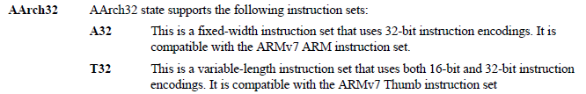
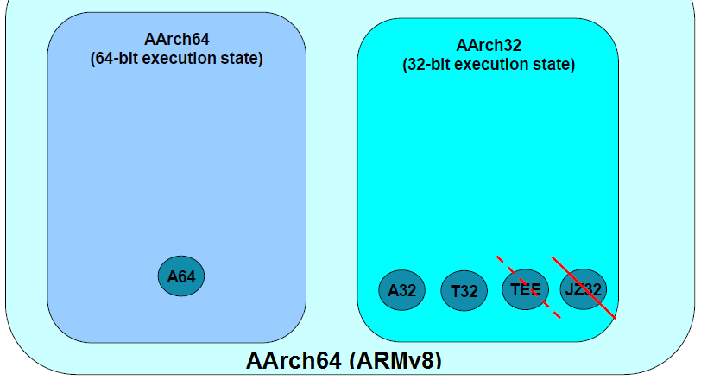
ARMv8 Instruction Sets
ARM Confidential IP Information (made available to FSL under mutual NDA or related license)

Slide 41
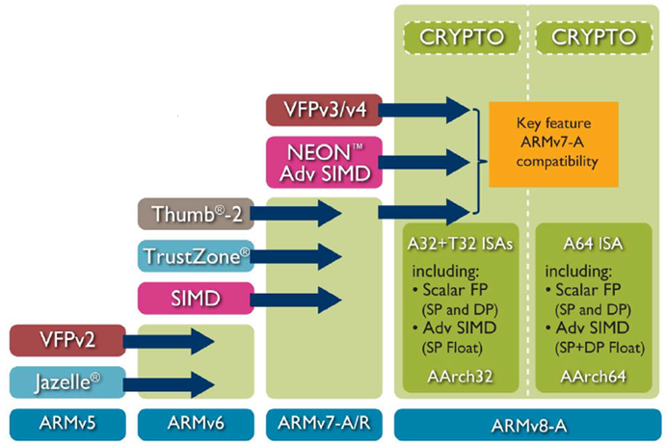
ARMv8 Fundamentals
Rather than sharing the instruction decoder between 32-bit and 64-bit instruction sets, ARM implements a separate decoder for A64
This means that when running 64-bit software the 32-bit part of the machine does not need to be active.
Limitation:
Transition between 32-bit and 64-bit
execution states can only occur on
exception boundaries
i.e. it is not possible to interleave
32 bit and 64 bit code
ARM Confidential IP Information
(made available to FSL under
mutual NDA or related license)

Slide 42
A64 – New Instruction Set (Basics)
Instruction semantics broadly the same as in AArch32 (ARMv7).
31 general purpose registers accessible at all times
General purpose registers are 64-bits wide.
No banking of general purpose registers.
Stack pointer is not a general purpose register.
PC is not a general purpose register.
Instruction level support for Cryptography – AES, SHA-1 and SHA-256
Additional dedicated zero register available for most instructions.
ARM Confidential IP Information (made available to FSL under mutual NDA or related license)

Slide 43
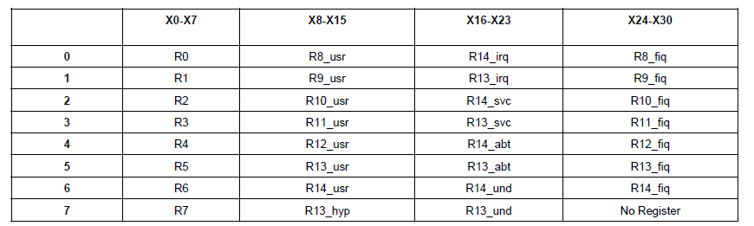
AArch64 Register File
ARM Confidential IP Information (made available to FSL under mutual NDA or related license)

Slide 44
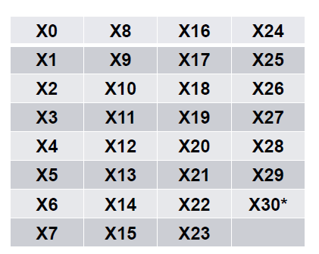
AArch64 (Un-Banked Registers)
64-bit General Purpose Register file used for:
Scalar Integer computation
32-bit and 64-bit
Address computation:
64-bit
31 general purpose registers accessible at all times
ARM Confidential IP Information (made available to FSL under mutual NDA or related license)

Slide 45
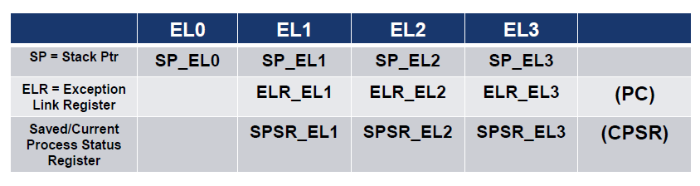
AArch64 (Banked Registers)
AArch64 Banked registers are banked by exception level
Used for exception return information and stack pointer
EL0 Stack Pointer can be used by higher exception levels after exception taken
Pre ARMv6 notion
ARM Confidential IP Information (made available to FSL under mutual NDA or related license)

Slide 46
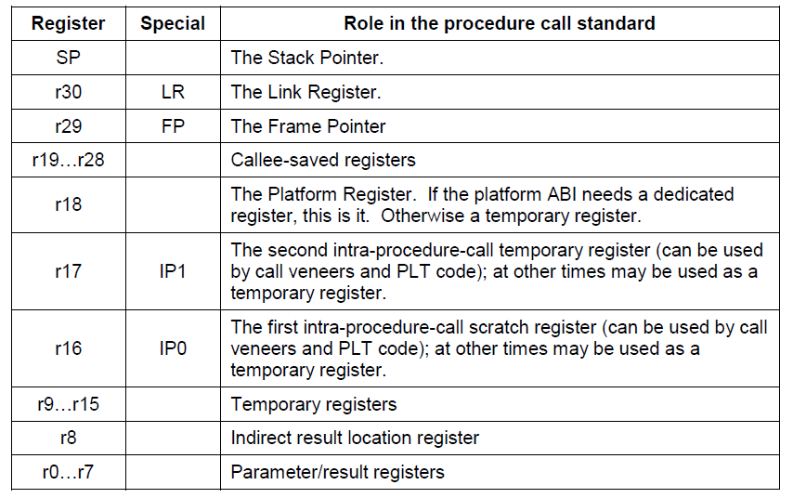
AAPCS64 (Procedure Call Standard)
ARM Confidential IP Information (made available to FSL under mutual NDA or related license)

Slide 47
ARMv8 Interrupt Model
To be taken up in the next section..

Slide 48
ARM Interrupt Model

Slide 49
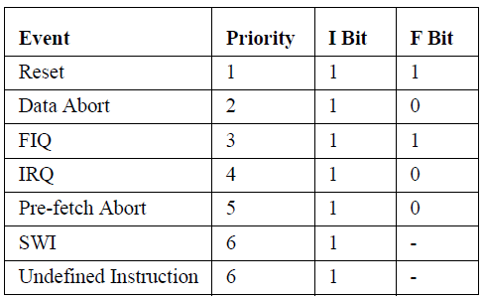
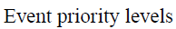
ARM processor Events (<= ARMv6)
ARM processor has 7 events that can halt the normal sequential execution of instructions.
Simultaneous multiple events :
- Current instruction will be completed no matter what event has been raised.
- Except when a data abort occurs on the first offending data address being accessed by LDM or STM.

Slide 50
ARM processor Events (<= ARMv6) [contd..]
Reset
Highest priority event.
Data Abort
Raised when attempting to read or write to a particular memory address.
FIQ
Highest priority interrupt.
Core enters SVC mode and interrupts are masked (both IRQ and FIQ bits are set to 1).
Occurs when the processor is powering up.
Occur when the memory controller or MMU indicates that an invalid memory address has been accessed.
Have a higher priority than FIQ’s.
Upon entry into FIQ handler the core disables both IRQ’s and FIQ’s interrupts.
Up on entry into a Data Abort handler, IRQ’s will be disabled and FIQ ‘s will be enabled.
Occurs when an external peripheral sets the FIQ pin to nFIQ.

Slide 51
ARM processor Events (<= ARMv6) [contd..]
IRQ
Occurs when an external peripheral sets the IRQ pin.
Pre-fetch
Abort
Occurs when an attempt to load an instruction results in a memory fault.
SWI
Occurs when the SWI instruction has been fetched and decoded successfully.
Core enters the SVC mode.
Upon entry to the IRQ handler the IRQ interrupts are disabled.
Second highest priority interrupt.
Occurs only if the instruction reaches the execution stage of the pipeline.
Undefined Instruction
Upon entry to the handler IRQ’s will be disabled, but the FIQ interrupts will remain enabled.
Occurs when an instruction not in the ARM/Thumb instruction set has been fetched and decoded successfully.
ARM “asks” the coprocessors if they can handle this coprocessor instruction.

Slide 52
ARM Exception Model (<= ARMv6)
When an exception occurs, the ARM:
Copies CPSR into SPSR_<mode>
Sets appropriate CPSR bits
Change to exception mode
Disable interrupts (if appropriate)
Stores the return address in LR_<mode>
Sets PC to vector address
To return, exception handler needs to:
Restore CPSR from SPSR_<mode>
Restore PC from LR_<mode>
0x1C
FIQ
0x18
IRQ
0x14
(Reserved)
0x10
Data Abort
0x0C
Prefetch Abort
0x08
Software Interrupt
0x04
Undefined Instruction
0x00
Reset
Vector Table
Vector table can be at 0xFFFF0000 also for HighVec configuration

Slide 53
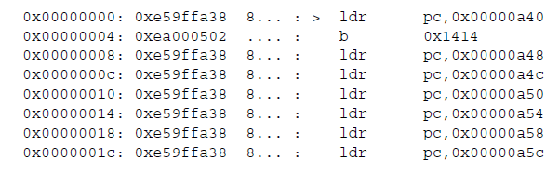
ARM Exception Model (<= ARMv6) [contd..]
Here we have a typical vector table of a real system:
Undefined Instruction
handler is located so that a simple branch is adequate
0x00000a40: DCD Reset_Handler
0x00000a48: DCD SWI_Handler
…..
Other vectors
require an indirect address using LDR
Remember DCD and Literal Pools ☺
LDR’s have an advantage that they can address a full 32 bits, whereas B
are limited to 24 bits
But LDR’s must load a constant located within a 4k of the vector table.

Slide 54
ARM Processor Modes (>= ARMv7)
Remember the ARM processor modes (<= ARMv6):
User
System
Supervisor
Abort
Undefined
FIQ
IRQ
Two new ARM modes introduced since ARMv7:
Monitor mode
Monitor mode is a Secure mode
S/W running in Monitor mode has access to both the Secure and Non-secure copies of system registers.
Hypervisor mode
Hyp mode is a Non-secure EL2 mode.
Used to provide virtualization support.

Slide 55
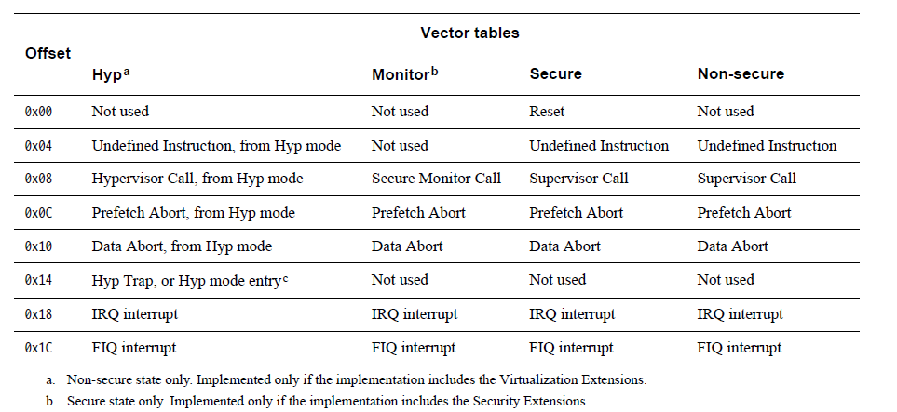
ARM Exception Model (>= ARMv7)
Architecture based around “Exception Levels” and Privilege Levels
EL0/EL1/EL2/EL3 and PL0/PL1/PL2/PL3
Exception levels broadly designed for one software “layer”
EL0 – Application
EL1 – OS Kernel
EL2 – Hypervisor (non-secure only)
EL3 – Secure Monitor

Slide 56
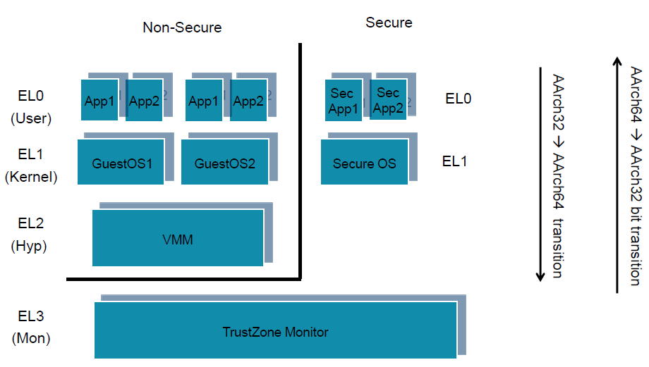
ARM Exception Model for AArch64 (64-bit architectures)
AArch64 - 64-bit Execution state.
AArch32 - 32-bit Execution state. Operation is compatible with ARMv7-A operation.

Slide 57
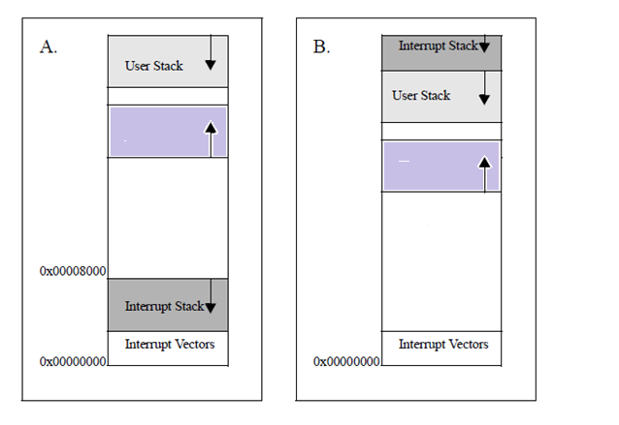
Setting up interrupt stacks
Before an interrupt can be enabled the IRQ mode stack has to be setup.
Normally done in the initialization code for the system (every time the processor
is reset).
Traditional stack layout with:
- Interrupt stack stored underneath Code Segment (CS).
Stack layout with:
- Interrupt stack stored above the user stack.
System will crash if Interrupt Stack
expands into the Interrupt vectors.
Interrupt Stack
stack grows into the user stack and does not corrupt the vector table.

Slide 58
Stack alignment requirements
For AArch32 architectures:
Stack must be aligned to a 8-byte boundary.
For AArch64 architectures:
Stack must be aligned to a 16-byte boundary.

Slide 59
ARM Interrupt Handlers

Slide 60
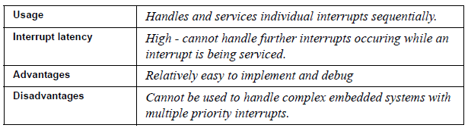
Simple non-nested interrupt handler
Simplest interrupt handler.
Interrupts are disabled until control is returned back to the interrupted task or process.
Not suitable for complex embedded systems which service multiple interrupts with differing priority levels.

Slide 61
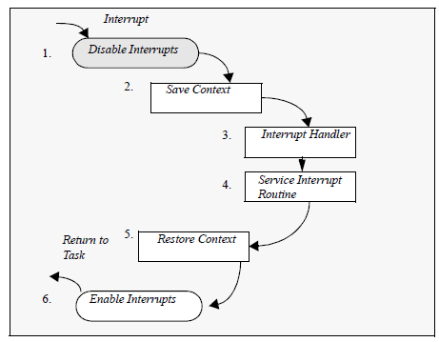
Simple non-nested interrupt handler [contd..]
1
Processor masks further external interrupts.
2
Upon entry to the handler, the handler code saves the current context of the non
banked registers.
3
Handler identifies the interrupt source and executes the appropriate
ISR.
4
ISR services the interrupt.
6
Enable interrupts and return .
5
Upon return from the ISR, the handler restores the context.

Slide 62
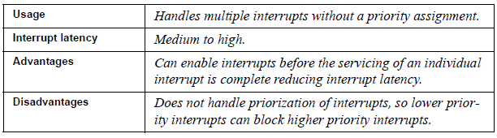
Nested interrupt handler
Allows for another interrupt to occur within the currently
called handler.
Achieved by re-enabling the interrupts before the handler has fully serviced the current interrupt.
Context restoration is prevented from interruption - so next interrupt will not overflow the stack, or corrupt any of the registers.

Slide 63
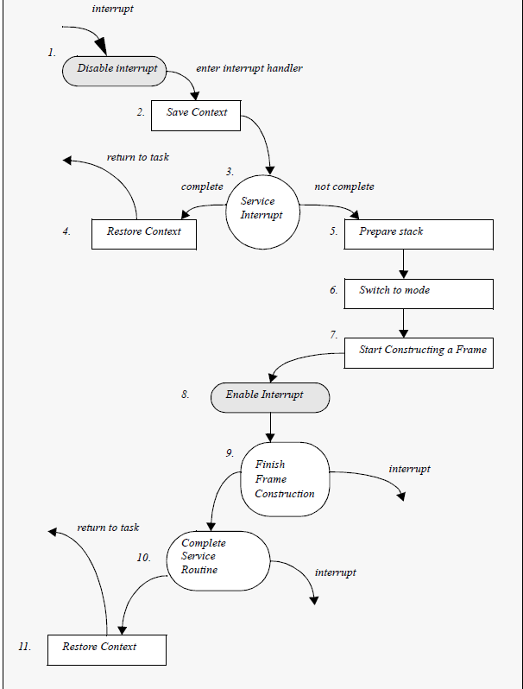
Nested interrupt handler [contd..]
Till stage 3:
Flow is similar to non-nested simple interrupt handler.
3
Handler tests a flag (which indicates whether further processing is required) and which is updated by the ISR.
5 and 6
In case the interrupts need to be re-enabled, core should be switched to SYSTEM mode to avoid lr_irq from being corrupted.
7
All registers saved on the IRQ stack (called a stack frame) must be transferred to the SYSTEM mode stack.

Slide 64
ARM Aborts

Slide 65
Understanding Aborts
Background
An abort is either:
Data Abort
Is associated with a data access as opposed to an instruction fetch.
Data aborts can be precise or imprecise.
Precise Data Abort
State of the system presented to the abort exception handler is always the state for the instruction that caused the abort.
an internal abort signaled by an error condition in the L1 or L2 cache.
an external abort signaled by the AXI interface because of an AXI error response.
an internal abort signaled by the MMU.
Easier to restart the processor after the exception handler has rectified the cause of the abort.
E.g.:
Permission faults reported by MMU.
External aborts to loads or stores to strongly ordered memory are precise.

Slide 66
Understanding Aborts [contd..]
Pre-fetch Abort
Is associated with an instruction fetch as opposed to a data access.
On a pre-fetch abort, the core marks the pre-fetched instruction as invalid, but does not take the exception until it executes the instruction.
After dealing with the cause of the abort, the handler executes SUBS PC, R14_abt, #4
This restores both the PC and the CPSR, and retries the aborted instruction.
Imprecise Data Aborts
State of the system presented to the abort exception handler can be the state for an instruction after the instruction that caused the abort.
Not possible to restart the processor from the point where the exception occurred.
E.g.:
External aborts other than loads or stores to strongly ordered memory and loads to the Program Counter or the CSPR.

Slide 67
ARM Development Tools

Slide 68
Development Tools
ARM Development Tools include
IDE
Compiler Suite
Debugger
Simulator
JTAP Debugging probe (hardware)

Slide 69
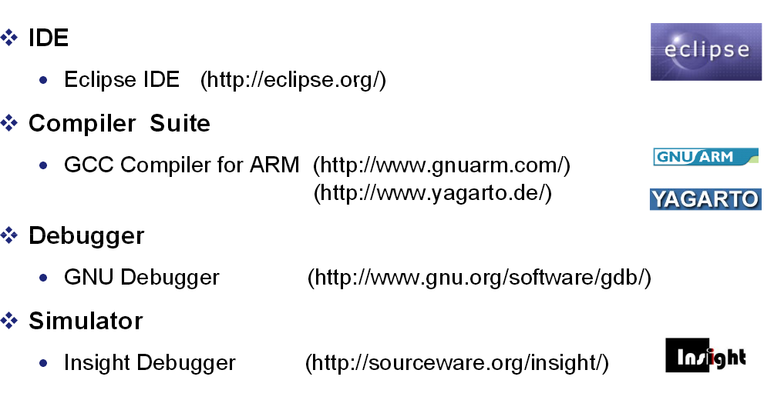
Development Tools [contd..]

Slide 70
RealView ICE
Debugging

Slide 71
RealView ICE debug Unit
About the RVI debug unit
The ARM RVI debug unit enables your debugger to connect to ARM processor-based targets using JTAG or Serial-Wire Debug (SWD).
RVI provides the software and hardware interface between a debugger running on a Windows or Red Hat Linux host computer, and a Joint Test Action Group (JTAG) IEEE Standard 1149.1-2001 port on the target hardware.
RVI also supports a SWD connection to the Debug Access Port (DAP). SWD is an alternative protocol to JTAG for connecting to CoreSight™ processors, and has the advantage of requiring fewer pins than previous probes. It also supports higher data rates.
You can use RVI with systems that contain one or more ARM processors. RVI also supports the Embedded Trace Buffer™ (ETB™) for capturing small amounts of trace information at high processor clock speeds.
RealView ICE (RVI) and RealView Trace 2 (RVT2) are ARM's legacy target connection units

Slide 72
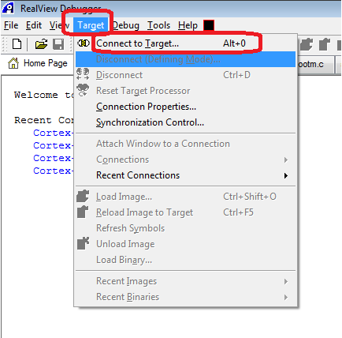
To create debugger setup configuration file
Connect RVI with D4400 board and power up both board and RVI

Slide 73
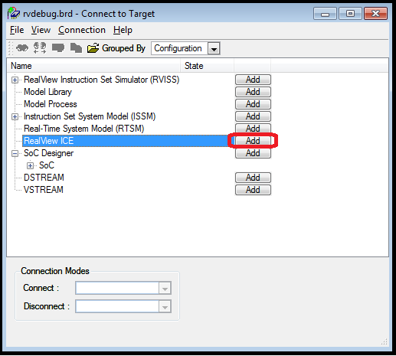
Connecting RVI

Slide 74
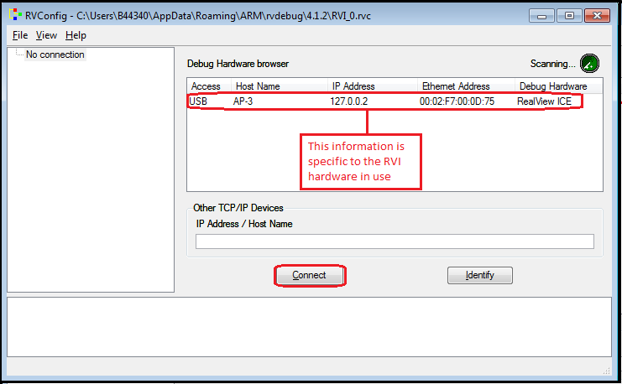
Connecting RVI contd.
Select the information specific to the RVI in use and press the connect button.
press “Connect” button.

Slide 75
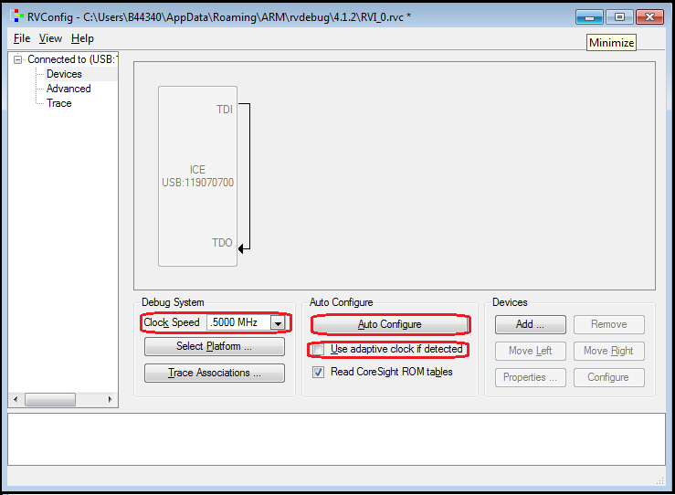
Configuration setup
Select clock speed to 500KHz. Disable option “Use adaptive clock if detected” and press “Auto Configure” option.

Slide 76
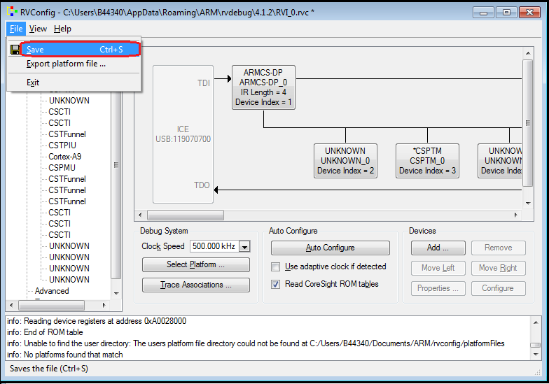
Configuration setup contd.
Press save and then exit

Slide 77
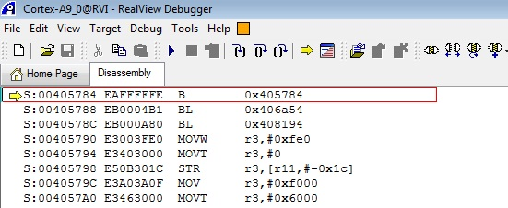
Debugging U-Boot
u-boot does a self-relocation at init time
This creates the need to configure debugger accordingly.
Before relocation
To debug u-boot before relocation, set D4400 board in test boot mode.
Switch settings for test boot mode are given below:
Board when connected with RVI will wait at below shown assembly instruction.

Slide 78
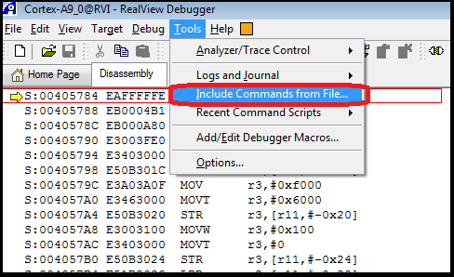
Debugging U-Boot
Configure PLL and DDR memory using RVI script PLL_DDR_config.inc.

Slide 79
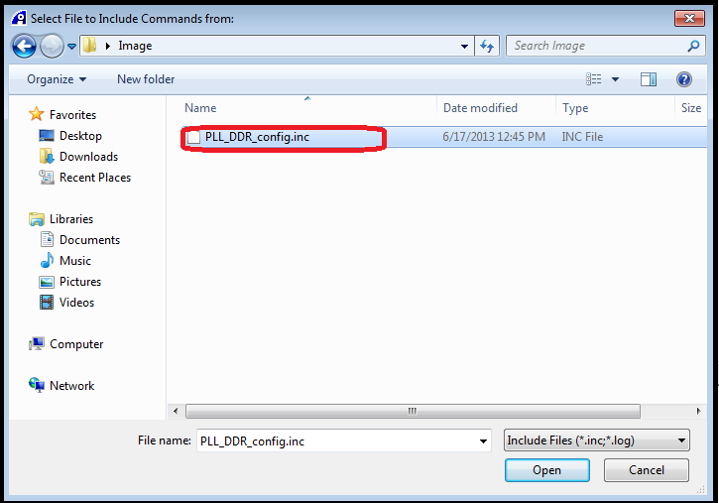
Debugging U-Boot contd.
Select the script PLL_DDR_config.inc

Slide 80
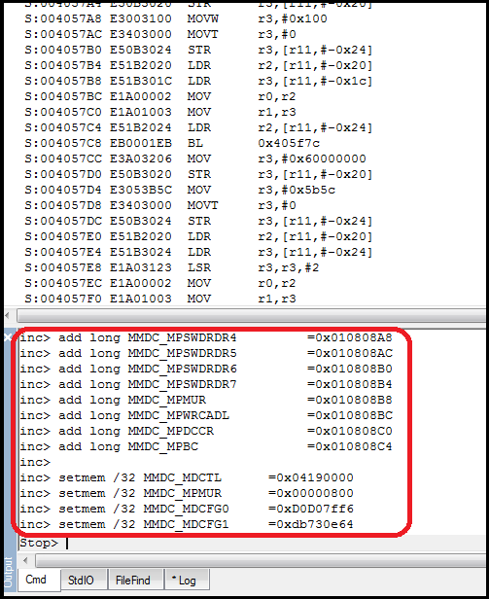
Debugging U-Boot contd.
Commands runs on output window of RVI
These commands configure PLL, OCRAM and DDR memory of D4400-EVB board

Slide 81
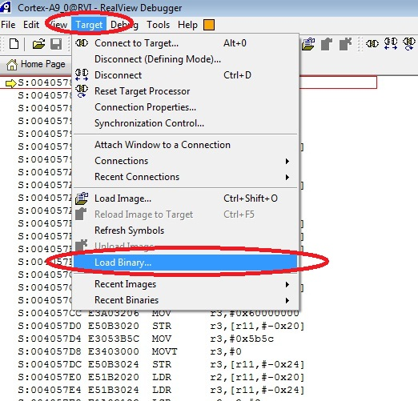
Debugging U-Boot contd.
Load u-boot binary

Slide 82
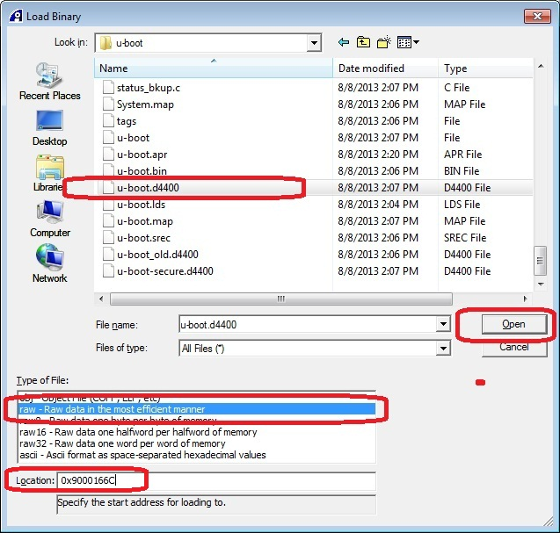
Debugging U-Boot contd.
Press open u-boot.d4400 Image
Select Location as 0x9000166C

Slide 83
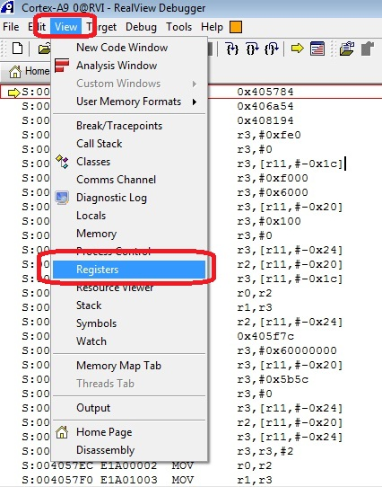
Debugging U-Boot contd.
Once u-boot.d4400 is loaded into DDR memory, update “Program counter” register (PC) to value 0x90002000

Slide 84
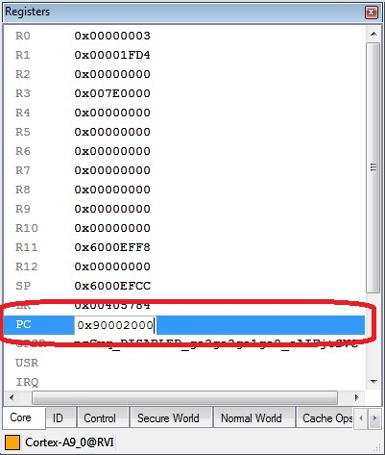
Debugging U-Boot contd.
Set PC at 0x90002000

Slide 85
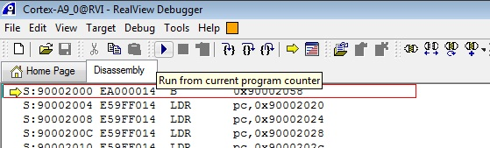
Debugging U-Boot contd.
Run the code from this PC

Slide 86
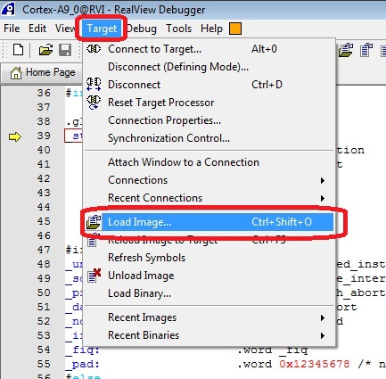
Debugging U-Boot contd.
Load u-boot symbol file

Slide 87
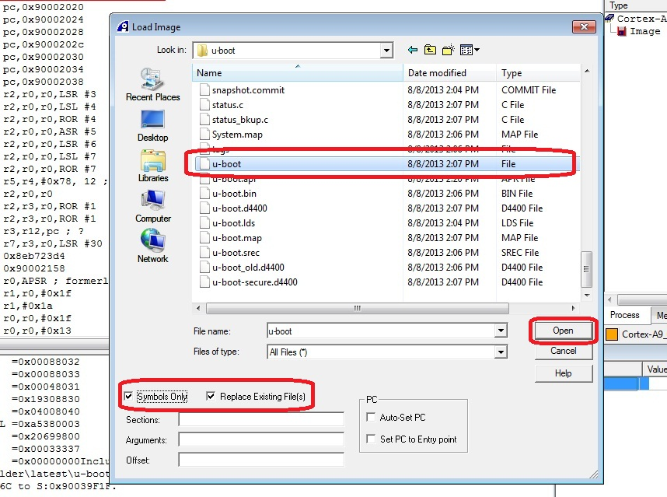
Debugging U-Boot contd.

Slide 88
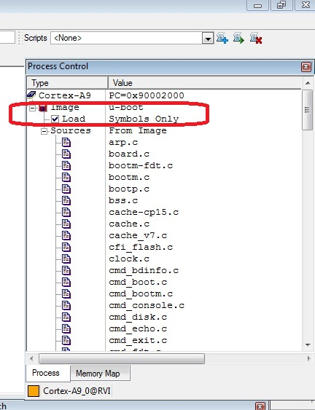
Debugging U-Boot contd.

Slide 89
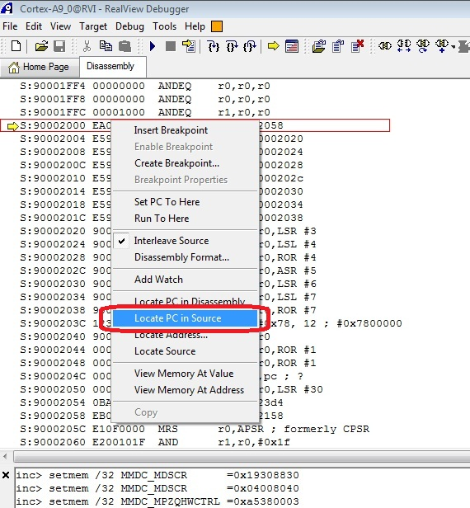
Debugging U-Boot contd.
Setting a breakpoint:
Locate PC (Program counter) and insert breakpoint in u-boot code

Slide 90
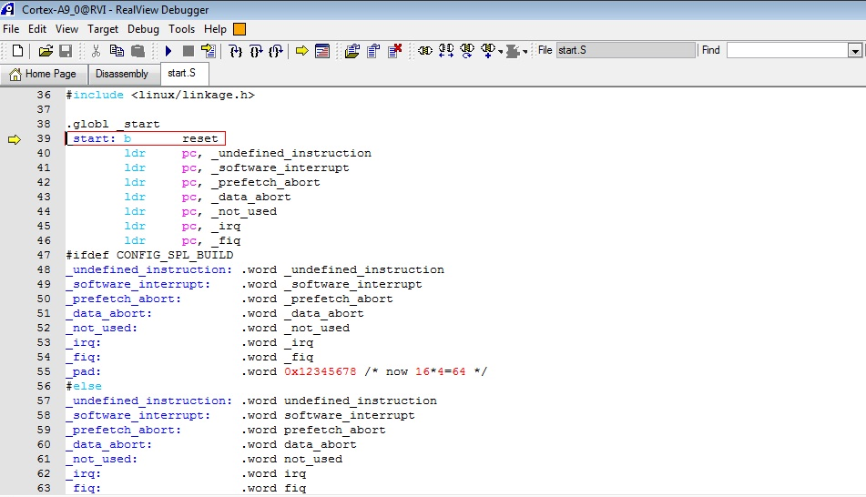
Debugging U-Boot contd.

Slide 91
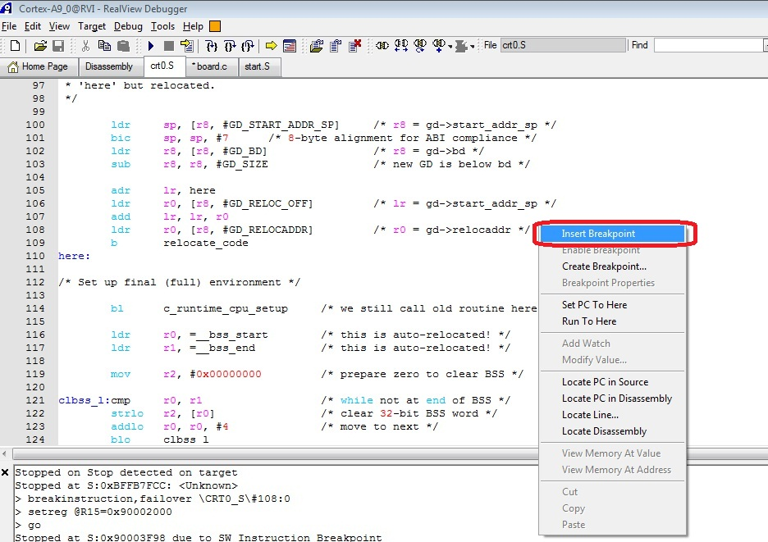
Debugging U-Boot contd.

Slide 92
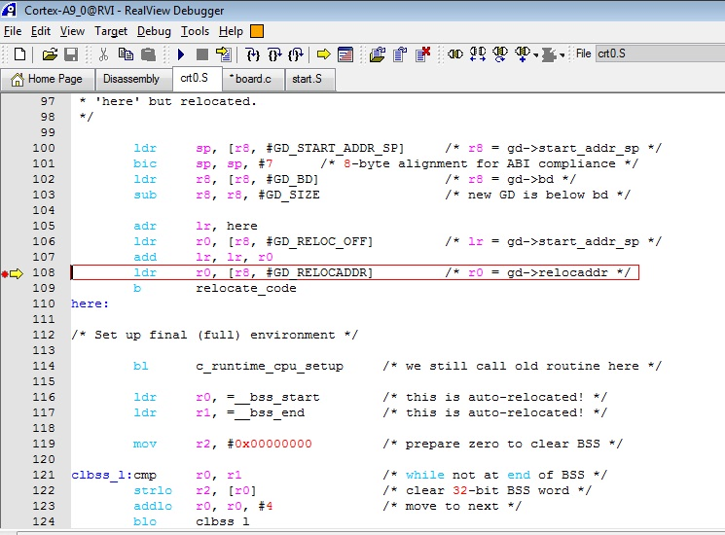
Debugging U-Boot contd.
The relocation instruction executed in u-boot source code.
A new symbol offset would be required now in order to debug using RVI.
Open “arch/arm/lib/crt0.S” file in before relocation

Slide 93
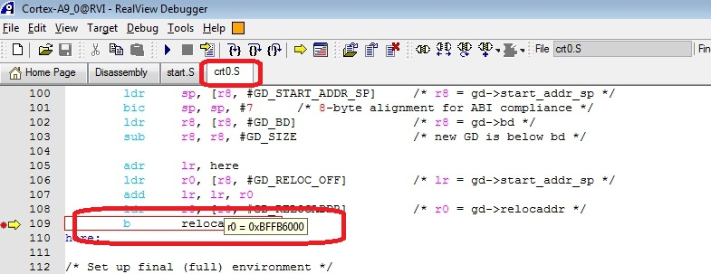
Debugging U-Boot contd.
Insert a breakpoint at line as shown in below snapshot.
Read register r0 value.
Calculating Offset:
Offset = relocation address (Register r0) – u-boot entry point
0ffset = 0xBFFB6000 – 0x90002000
Offset = 0x2FFB4000

Slide 94
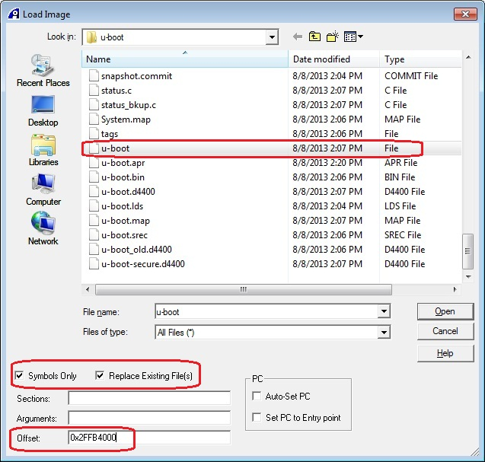
Debugging U-Boot contd.
After relocation
U-boot debugging after relocation requires u-boot symbol file along with shift offset value (As calculated in previous section):

Slide 95
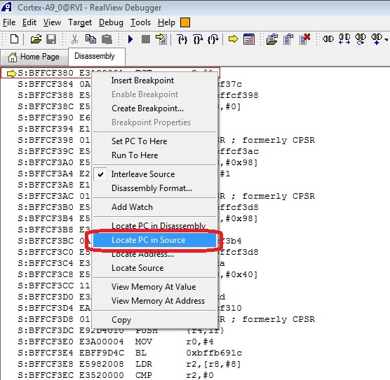
Debugging U-Boot contd.

Slide 96
Debugging Linux
Debugging kernel code
Setting RVI for kernel debugging
Load Linux kernel symbol file

Slide 97
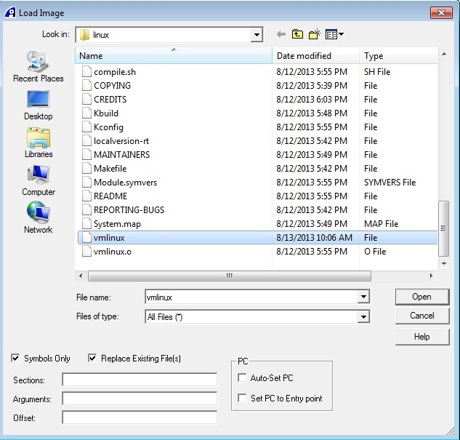
Debugging Linux contd.
Select vmlinux kernel file

Slide 98
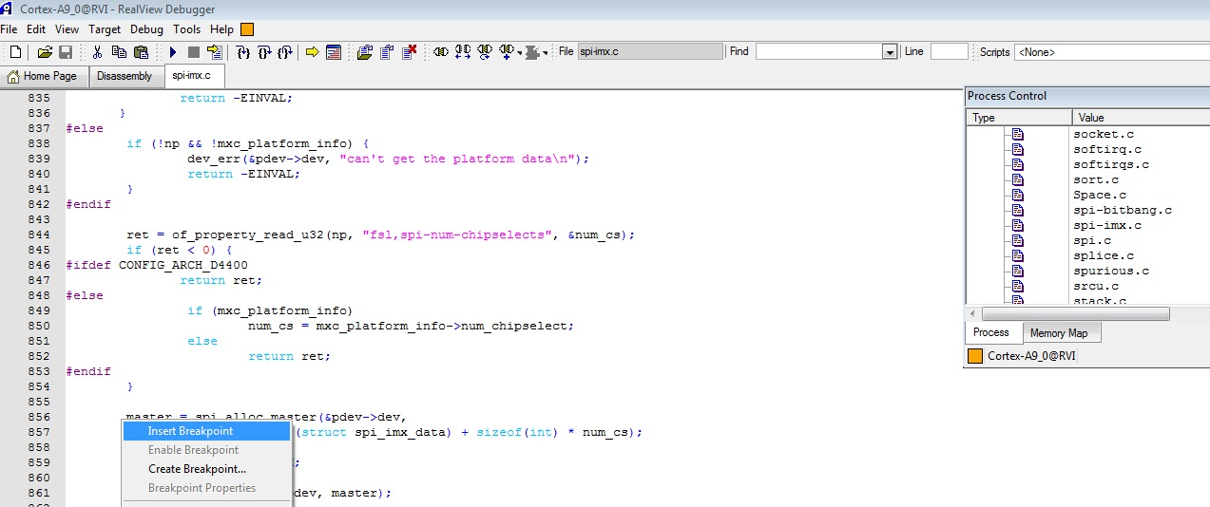
Debugging Linux contd.
Open a code file and insert breakpoint

Slide 99
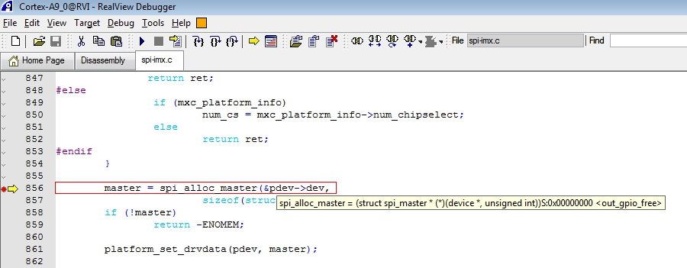
Debugging Linux contd.
Boot Linux kernel from u-boot prompt.
Breakpoint would be hit in code

Slide 101
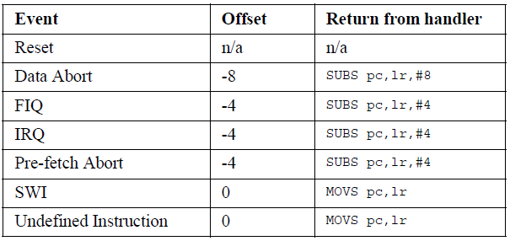
Returning from an interrupt handler
‘S’ at the end of the instruction indicates:
- Destination register is PC
- CPSR is automatically updated
Due to the processor pipeline, the return address from an interrupt or exception handler has to be manipulated.
This means that the value of the offset has to be subtracted from the link register, l_{r}
-8 :
Return address will be the original
instruction that caused the Data Abort
-4 :
FIQ handlers return one instruction before the instruction pointed to
by lr
-4 :
IRQ handlers return one instruction before the instruction pointed to
by the lr

Slide 102
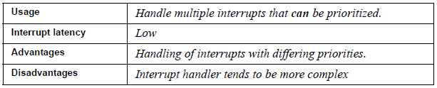
Re-entrant interrupt handler
Method of handling multiple interrupts where interrupts are filtered by priority.
Interrupts with higher priority should have a lower latency.
Interrupts are re-enabled early on in the interrupt handler to
achieve low interrupt latency.

Slide 103
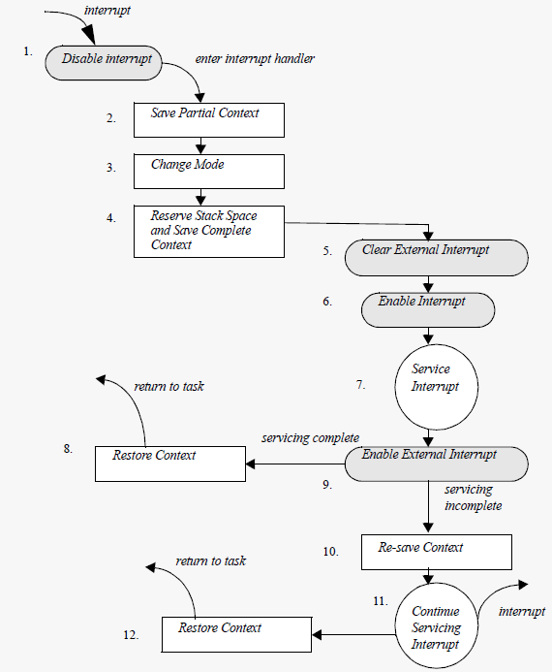
Re-entrant interrupt handler [contd..]
3
interrupt
routine should swap into SYSTEM mode.
5
Interrupts must be disabled at
source by setting a bit in the interrupt controller.
6
Re-enable interrupts via the CPSR
7
Enable interrupts at
source (interrupt controller).
.

